Slide 1
2025 5th International Conference on Expert Clouds and Applications (ICOECA)
Track: Track - 1 (Cloud Infrastructure & AI/ML for Cloud Security)
Paper ID: ICOECA 287
Paper Title: DDoS Protection System for Cloud using AWS and Machine Learning
Author Name: Shaurya Srinet, Shounak Chandra, Charvi Jain, Dr. Balaji Srikaanth P, Dr. Nagendra Prabhu S

Slide 2

Outline of the Presentation
Introduction
Methodology
Results And Discussions
Conclusion
References
Notes:
This is the master slide and within the blue band we can have the respective college name in case we are presenting for one of our institutions. When it is for the overall university we need not have that

Slide 3
Introduction
Effective DDoS Protection – The system successfully integrates anomaly detection, load testing, and AWS cloud services to ensure resilience and high availability.
Dynamic Scaling & Traffic Management – AWS Auto Scaling and Load Balancer dynamically adjust resources to handle traffic spikes while real-time monitoring and alerts detect anomalies.
Enhanced Anomaly Detection – Future improvements could include advanced machine learning, deep learning, and ensemble methods for better accuracy in detecting complex attack patterns.
Real-Time Mitigation & Threat Intelligence – Rate-limiting, firewalls, and threat intelligence feeds can enhance attack detection and response speed.
Faculty of Engineering and Technology
Notes:
This is the master slide and within the blue band we can have the respective college name in case we are presenting for one of our institutions. When it is for the overall university we need not have that

Slide 4
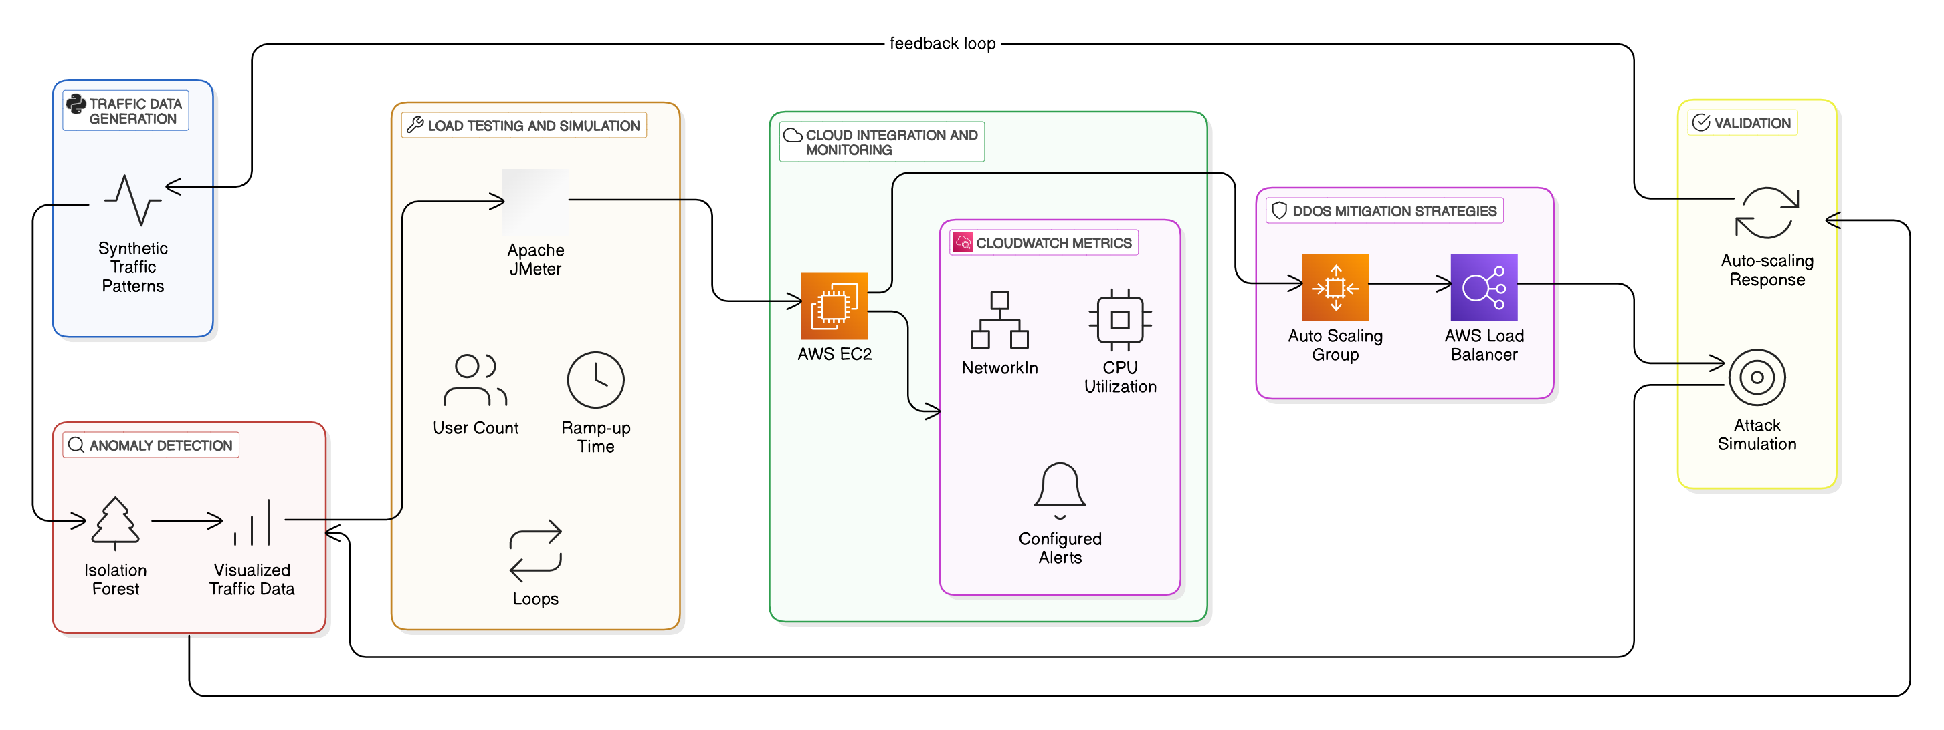
Methodology
Notes:
This is the master slide and within the blue band we can have the respective college name in case we are presenting for one of our institutions. When it is for the overall university we need not have that

Slide 5
Results and Discussion
The anomaly detection system, using the Isolation Forest Algorithm, successfully identified DDoS attempts, while AWS Auto Scaling, Load Balancers, and CloudWatch monitoring ensured high availability, resilience, and efficient traffic distribution under simulated heavy loads and attack scenarios.
Notes:
This is the master slide and within the blue band we can have the respective college name in case we are presenting for one of our institutions. When it is for the overall university we need not have that

Slide 6
Conclusions
Effective DDoS Protection – Demonstrated a cloud-based system using Isolation Forest, Apache JMeter, and AWS (Auto Scaling, Load Balancer, CloudWatch) for resilience under attack.
Dynamic Scaling & Monitoring – AWS Auto Scaling & Load Balancer managed traffic, with real-time monitoring detecting anomalies early.
Enhanced Anomaly Detection – Future improvements include deep learning, ensemble models, and advanced ML techniques
Real-Time Mitigation – Plans to integrate firewalls, rate-limiting, and threat intelligence for faster response.
Notes:
This is the master slide and within the blue band we can have the respective college name in case we are presenting for one of our institutions. When it is for the overall university we need not have that

Slide 7
References
A. Odeh, A. Aboshgifa, and N. Belhaj, "Mitigating DDoS Attacks in Cloud Computing Environments: Challenges and Strategies," in Proceedings of the IEEE Conference on Cloud Computing, 2023, pp. 92–100.
Jyoti Prajapati, Indrajeet Kumar, and Krishna Kant Agarwal, " Detection of DDoS Attacks in Cloud Computing Environments Using Machine Learning Techniques," IEEE Commun. Surv. Tutorials, Fourthquarter 2024, doi: 10.1109/TIACOMP64125.2024.00020.
Saakshi Narula, Arushi Jain, and Prachi, "Cloud Computing Security: Amazon Web Service," in Proc. IEEE Conf. Electron. Comput. Technol., 2013, pp. 415–425, doi: 10.1109/ACCT.2015.20.
Marwan Darwish, Abdelkader Ouda, and Luiz Fernando Capretz, "Cloud-based DDoS Attacks and Defenses," in Proc. IEEE Conf. Cloud Comput., 2013, pp. 279–287.
Notes:
This is the master slide and within the blue band we can have the respective college name in case we are presenting for one of our institutions. When it is for the overall university we need not have that

Slide 8
References contd.
Hedjaz Sabrine, Baadache Abderrahmane, and Semchedine Fouzi, "Comparative Study of Security Methods Against DDoS Attacks in Cloud Platforms," IEEE Access, vol. 9, pp. 113279–113291, 2019, doi: 10.1109/ISNCC.2019.8909110.
Anukriti Naithani, Shailendra Narayan Singh, Krishna Kant Singh and Sushil Kumar, " Machine Learning for Cloud-Based DDoS Attack Detection: A Comprehensive Algorithmic Evaluation," IEEE Trans. on Emerging Topics in Computing, 2023, doi: 10.1109/Confluence60223.2024.10463504.
Neha Agarwal and Shashikala Tapaswi, " Defense Mechanisms Against DDoS Attacks in a Cloud Computing Environment: State-of-the-Art and Research Challenges," IEEE Internet Computing, vol. 24, no. 2, pp. 34–42, 2019, doi: 10.1109/COMST.2019.2934468.
Notes:
This is the master slide and within the blue band we can have the respective college name in case we are presenting for one of our institutions. When it is for the overall university we need not have that

Slide 9


